Slide 1
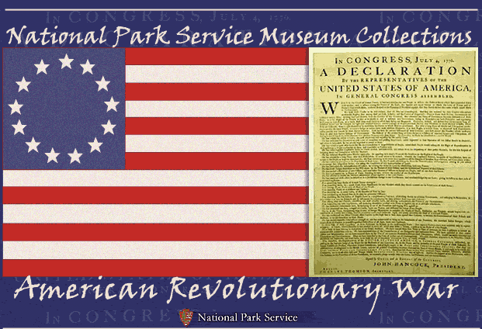
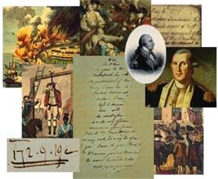
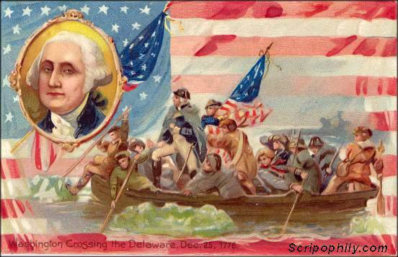
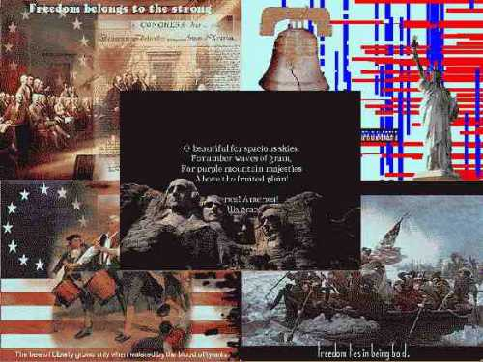
Causes of the Revolution
You need chromebook

Slide 2
Objective
Identify and describe the primary causes of the American Revolution.
Show video part 2
Finish Causes of the American Revolution
Begin Comic Strip (Fold a Blank piece of Computer paper into 8 parts.
  Finish headings (the headings from slides 4 - 6, 8 - 11)
  Find 3 facts about each event
    What happened?
    What were the consequences of the event?
    How did the Colonists react to the consequences.

Slide 3
England Gets Involved
For over 100 years England left the colonists in the 13 colonies alone to govern themselves.
After the French and Indian War, England was in debt and decided to impose taxes on the colonists to pay that debt.
Over the next years many additional taxes, Acts, and laws were passed by Parliament, England’s government.
The colonists were very upset because they did not have a representative in Parliament to speak for the colonies. They called this “Taxation Without Representation”.
Some of these laws included:

Slide 4
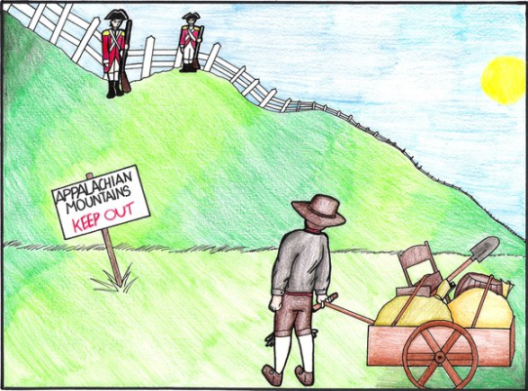
Proclamation of 1763
Prohibited colonists from settling west of the Appalachian Mountains
Brought in 10,000 British troops to keep the settlers out of the Ohio Valley.
Taxed the colonists to pay for the 10,000 soldiers.
Imagine fighting a war to get new land and then being told you couldn’t go there.
What would you do?

Slide 5
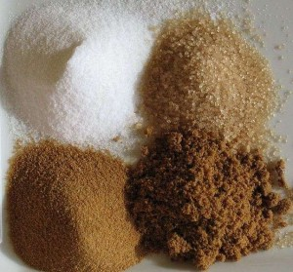
Sugar Act of 1764
Lowered the tax on imported sugar and molasses.

Slide 6
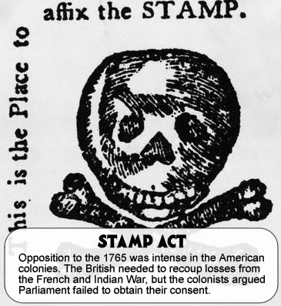
Stamp Act of 1765
Required stamps to be purchased and placed on newspapers, almanacs, pamphlets, books, legal documents, playing cards or any paper products.

Slide 7
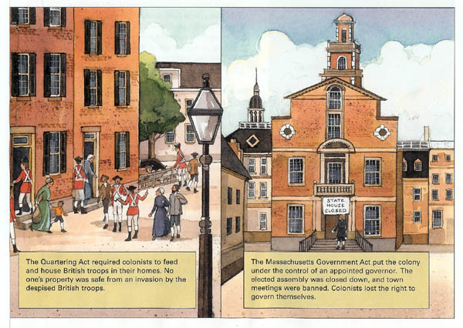
Quartering Act of 1765
Required the colonists to provide shelter and supplies to British troops.

Slide 8
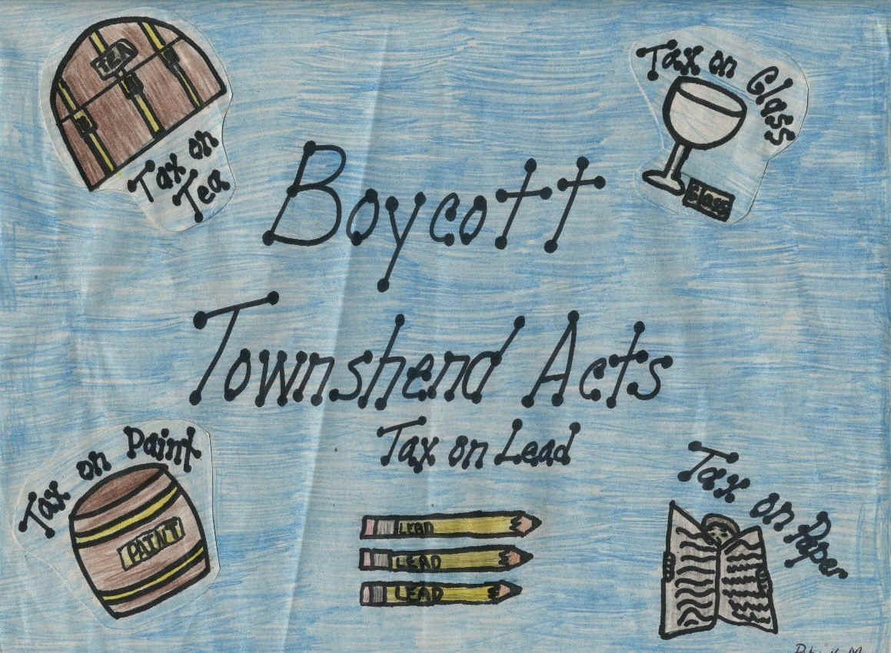
Townshend Acts of 1767
Imposed a tax on imported goods like glass, lead, paint, paper and tea.

Slide 9
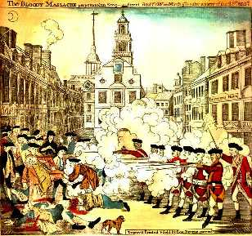
Boston Massacre of 1770
Encounter between British troops and citizens of Boston
Patriots antagonized British troops, who were quartered in Boston for the purpose of discouraging demonstrations against the Townshend Acts.
British troops fired on the Patriots, killing 5 people
Look at the picture.
Who appears to be the aggressor (the one starting everything)?
What are the people on the left doing?
Do you think this is an accurate portrayal of the the event? Explain your answer.

Slide 10
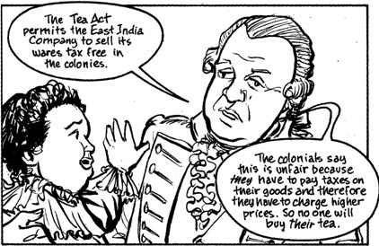
Tea Act of 1773
Permitted the British East India Tea Company to sell tea at a lower price than colonial tea companies.

Slide 11
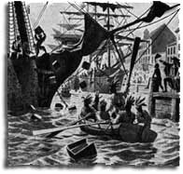
Boston Tea Party of 1773
A protest against the Tea Act of 1773.
Colonist dressed as Native Americans and dumped British tea into Boston harbor.
For what reason did the colonists dress up as Native Americans when they dumped the tea?

Slide 12
Coercive/Intolerable Acts of 1774
Closed down state legislatures.
Closed Boston harbor.

Slide 13
Closure
How did these taxes, laws and events cause the American Revolution?

